Slide 1
Native VS Hybrid Mobile Apps
Senthil Kumar
senthil@indix.com

Slide 2
About me
Mobile App Developer @ Indix
Working on iOS & Android apps.
Ex- Ness employee – Bangalore.
Worked on EPL football apps & ATP Tennis mobile apps.

Slide 3
Agenda
Magic Quadrant for Mobile
Native Platforms
Advantages & Disadvantages of Native Approach
Hybrid Apps
HTML5 Approaches & Key Players
HTML5 Myth VS Reality
Adobe – PhoneGap
Mobile @ Scale
Case Studies – LinkedIn, Facebook & Dropbox
Conclusion

Slide 4
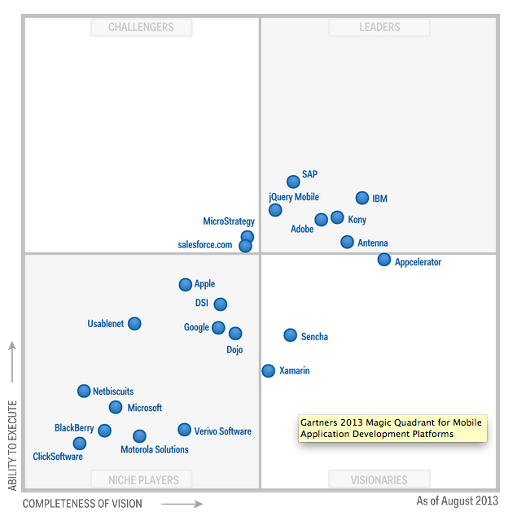
Magic Quadrant for Mobile Application Development Platforms

Slide 5
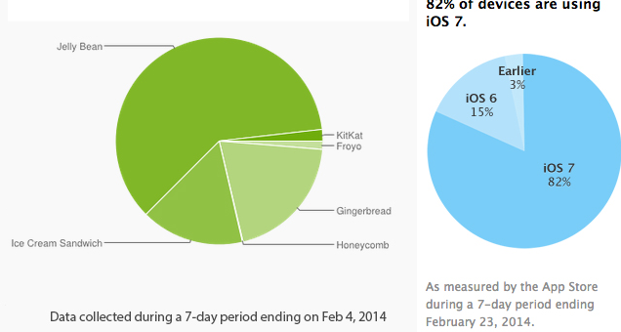
Android vs iOS

Slide 6
Native Apps
User prefers native apps
- 80 % of time is spent on apps and 20 % on browsers(Flurry report)
High User Engagement & Smoother Experience
Faster adoption to support new OS Versions
Offline support and Hardware access
Monetization

Slide 7
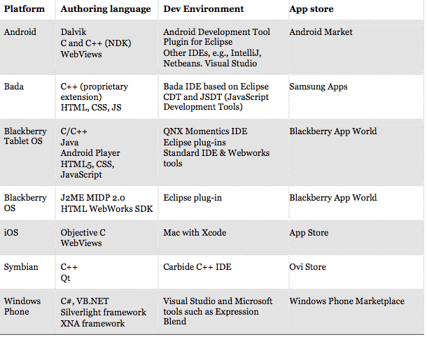
Languages & Environment

Slide 8
What Stops from using Native?
Platform dependent – code can’t be reused
Multi skill set and tool requirement
Higher TCO (Total cost of ownership)

Slide 9
Hybrid Apps
It’s a bridge between Native and Web Apps
Cross platform reach is more
Instant products update
Data guides them on future decisions (A/B testing)

Slide 10
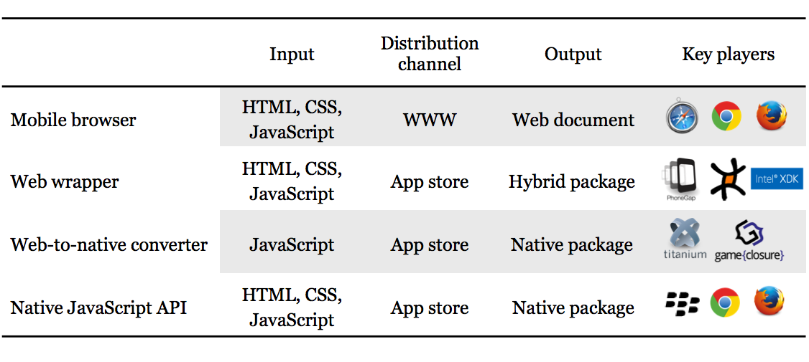
HTML5 routes to Market

Slide 11
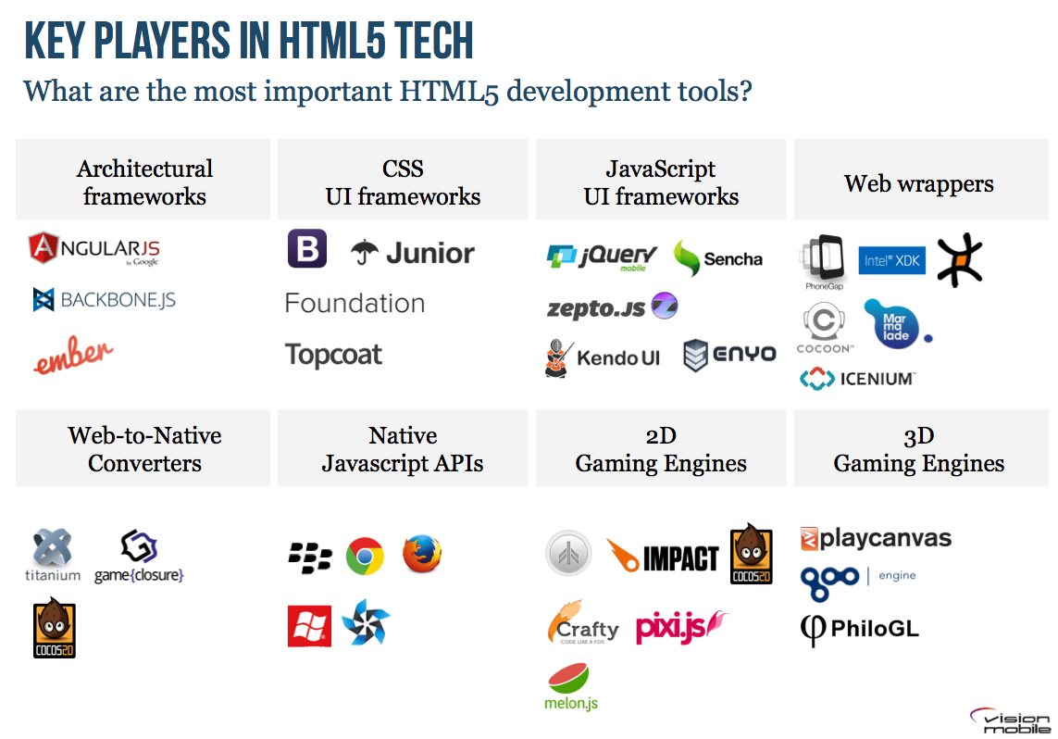

Slide 12
Issues with Hybrid Apps
Performance issues
Lack of multithreaded strategy
Problem with DOM manipulation and layout
Memory Management
Lack of debugging tools

Slide 13
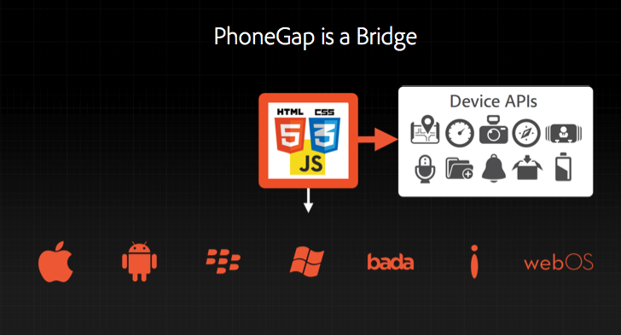
Adobe PhoneGap
Cross platform reach is more
Supports jQuery mobile, Backbone.js, Bootstrap from twitter, Angular.js and so on…

Slide 14
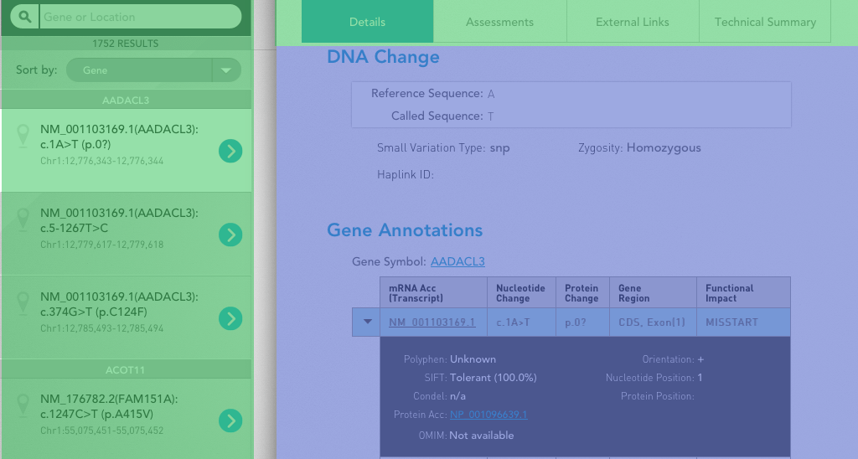
Mix up Native & HTML

Slide 15
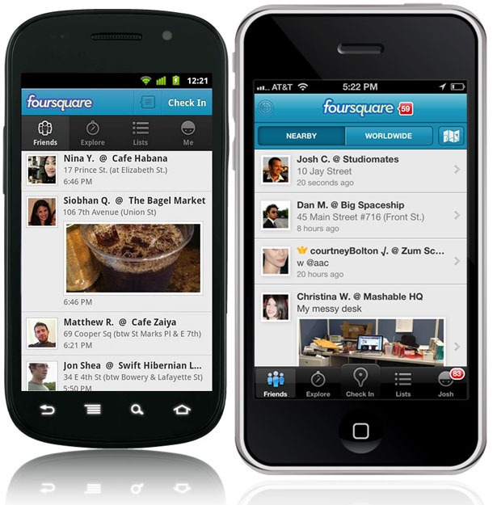
A good cross-platform application looks at home on whatever platform it is used on. A bad cross-platform tries to look identical everywhere

Slide 16
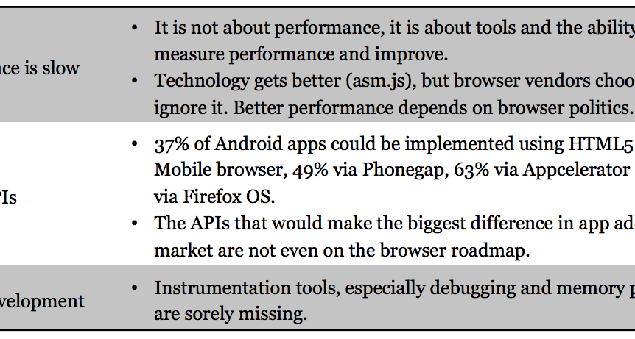
Myth VS Reality

Slide 17
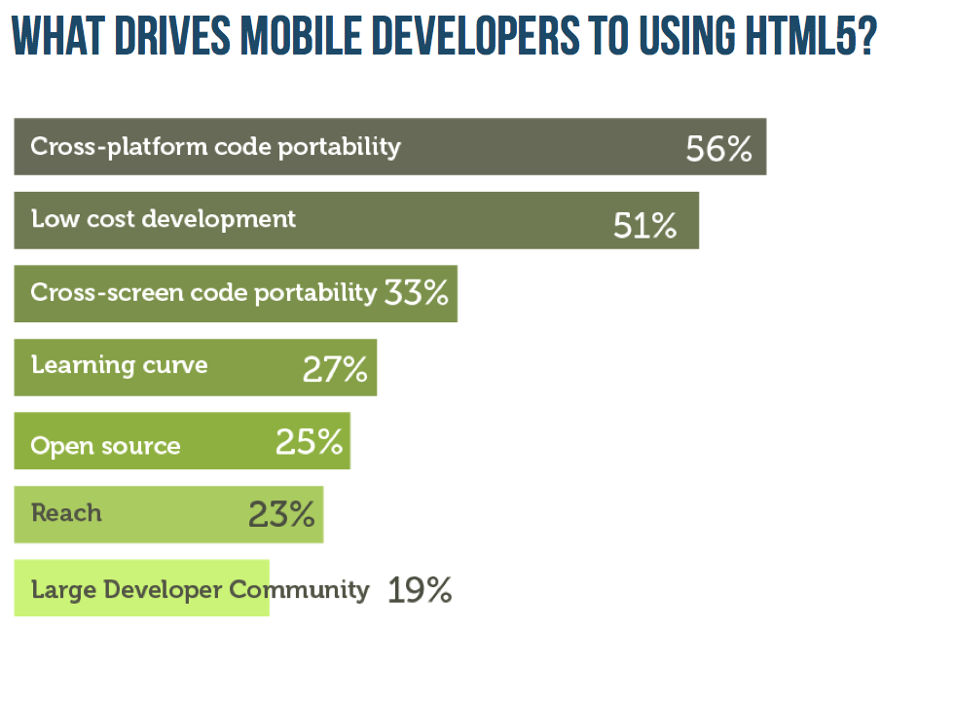

Slide 18
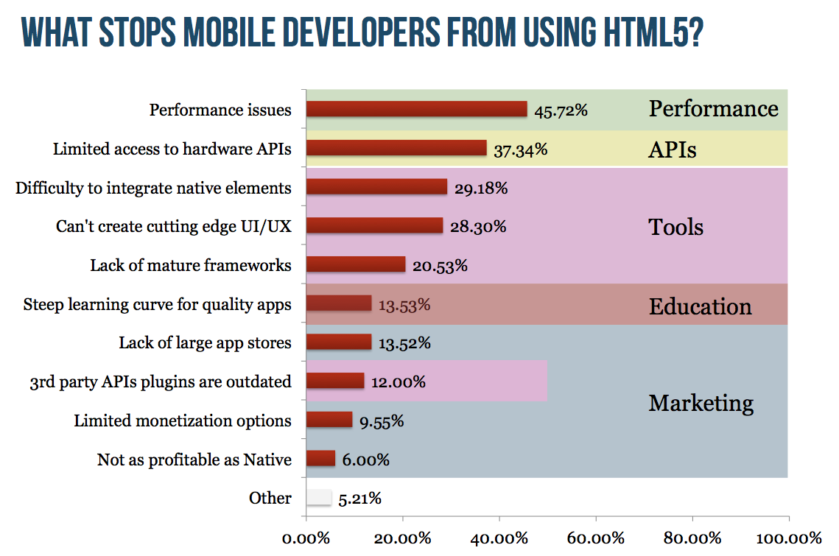

Slide 19
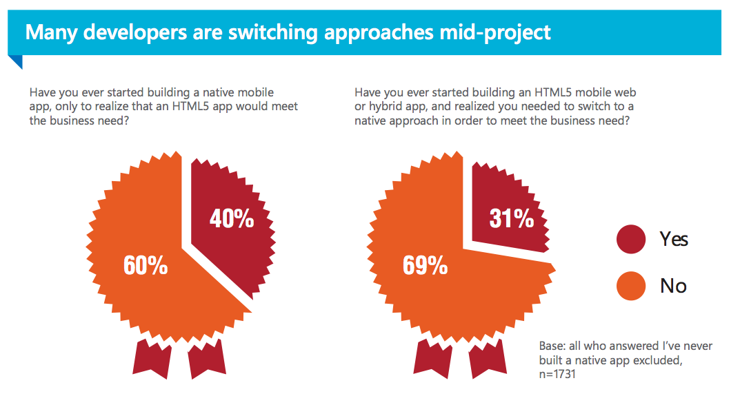
Swap??

Slide 20
Mobile @ Scale
Focus on Speed
Experimentation for all
Measurement
Scaling teams
Scaling Applications
Motion Design

Slide 21
LinkedIn – Why they dumped HTML5?
Lack of debugging and performance tools
Lack of runtime diagnostics information
High crash rates due to memory exhaustion
Animations and spinners smoothness are not great

Slide 22
Facebook
Initially FB built mobile app using HTML5 and javascript in a native wrapper, a hybrid solution.
Why FB went Native?
- Better touch tracking support, especially on Android.
- Smoother animations are always an asset.
- Better caching.
- AppCache is soooooo busted we stopped using it

Slide 23
Dropbox
Share client side code across platforms
Client code was written in C++
Mostly data layer, sync, cache etc.
Build a library – use it for Android and iOS

Slide 24
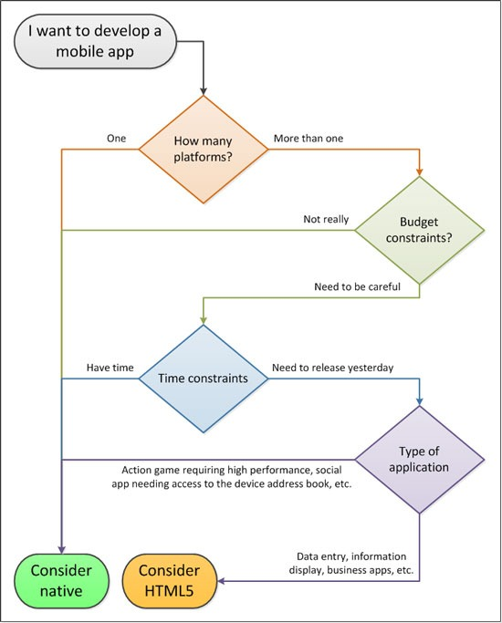

Slide 25

Questions?

Slide 26
Thanks!

